Slide 1
High School 2022
Update to the School Board
December 8, 2016

Slide 2
Goal
By February 2017, the Board will identify a vision for high schools using multiple sources of information, data and feedback that prepares young people to graduate ready to enter adult life.
Notes:
How presentation will benefit audience: Adult learners are more interested in a subject if they know how or why it is important to them.
Presenter’s level of expertise in the subject: Briefly state your credentials in this area, or explain why participants should listen to you.

Slide 3
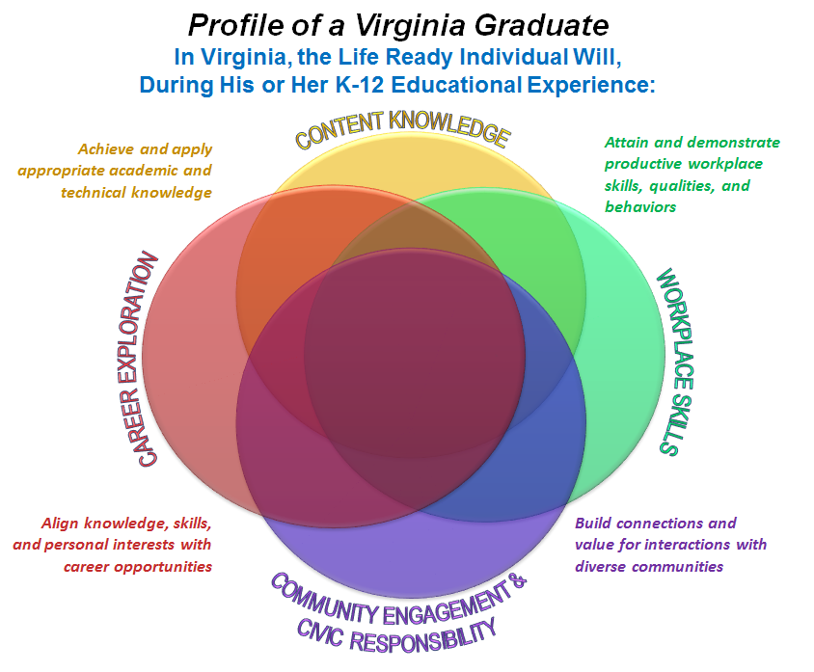
Profile of a Virginia Graduate

Slide 5
Communication and Feedback
HS 2022 Website
Community and staff outreach
Community Advisory Council

Slide 6
High School Council
Administrator and teacher representatives from all high schools and CATEC, lead instructional coaches, middle school principal
Deliverables
  Draft High School Program Guide
  Sample Student Pathways

Slide 7
HS Council—work to date
Focused first on why we need to change
Studied and presented innovative programs
Solicited input from school site based teams
Identified current practices that promote PoVG

Slide 8
Our “Plate”
Our current goal, strategic plan and lifelong learner competencies have us on the pathway to the PoVG
ACPS graduates will be:
  Self-advocates
  Effective communicators and collaborators
  Academically accomplished
  Responsible Citizens
  Critical Thinkers
  Creative Problem Solvers

Slide 9
What yearly themes/common experiences would help make our vision a reality?
Thematic focus at each grade level
  9—Self-exploration and Foundations
  10—Collaboration and Discovery
  11—Community and Connections
  12—Passion and Transition
Achieved through a dedicated “seminar” class and through incorporation of the theme in other classes

Slide 10
What changes would we make to our current rules/policies that will change our culture so that student choices are driven by their passions?
Allow students to “pitch” credit ideas
  Eagle Scout, work-based learning, athletics, drama
Create options for ¼ and ½ credit electives
Create an equally distributed grading scale, allowing P/F options
Consider changes to weighted grades
Revise add/drop practices
Partial lottery for any classes/programs requiring application
Rethinking how we use time in the building--central
Rethinking class sizes--central

Slide 11
Next steps
Hearing ideas from the board from their field trips/case studies
Bringing ideas to site based teams for feedback
Developing the instructional program needed to accomplish our goals
Developing pathways for students
Creating “Tables of Specifications”
Draft Program Guide and Pathways presented to the Board in February

Slide 12
Breakout sessions
Guiding questions:
  Learning time—How can school hours, class periods, semesters, etc. be changed to move us toward our goal?
  Learning spaces—What was unique about learning spaces you observed? How did these changed spaces influence and impact instruction and learning?
  Curriculum—What innovations have you seen in curriculum, i.e. interdisciplinary classes, alternate routes to course credit, etc.?
  Pedagogy—What did you see in regard to innovative pedagogy—co-teaching, virtual, etc.?
  Relationships—What structures do the schools you visited have in place that foster the development of strong, long-term student-teacher relationships?

Slide 13
Breakout Groups
241 | 320 | Rivanna Conference Room
Jonno Alcaro Pam Moynihan | Graham Paige Jason Buyaki Dave Oberg | Steve Koleszar Kate Acuff

